Slide 1
SHORTEST PATH ALGORITHM
Ashish aggarwal
181210012
B.TECH CSE 2ND YEAR

Slide 2
SHORTEST PATH PROBLEMS
Shortest path algorithms are a family of algorithms designed to solve the shortest path problem. The shortest path problem is something most people have some intuitive familiarity with: given two points, A and B, what is the shortest path between them?
In computer science, however, the shortest path problem can take different forms and so different algorithms are needed to be able to solve them all.
Shortest path algorithms have many applications. Mapping software like Google or Apple maps makes use of shortest path algorithms. They are also important for road network, operations, and logistics research. Shortest path algorithms are also very important for computer networks, like the Internet.

Slide 3
SINGLE-SOURCE SHORTEST PATH
The single-source shortest path problem, in which we have to find shortest paths from a source vertex v to all other vertices in the graph.
The single-destination shortest path problem, in which we have to find shortest paths from all vertices in the directed graph to a single destination vertex v.

Slide 4
Dijkstra’s Algorithm
•Dijkstra's algorithm (or Dijkstra's Shortest Path First algorithm, SPF algorithm) is an algorithm for finding the shortest paths between nodes in a graph, which may represent, for example, road networks.
•We generate a SPT (shortest path tree) with given source as root. We maintain two sets, one set contains vertices included in shortest path tree, other set includes vertices not yet included in shortest path tree.
•At every step of the algorithm, we find a vertex which is in the other set (set of not yet included) and has a minimum distance from the source.
Time Complexity for Dijkstra’s Algorithm is given by
O( |V|² )
Using min heap time complexity can be reduced to
O( |V|* log(|V| )

Slide 5
Dijkstra’s Algorithm
•Dijkstra’s algorithm solves the single-source shortest-paths problem on a weighted, directed graph G(V, E) for the case in which all edge weights are nonnegative.
•Below are the detailed steps used in Dijkstra’s algorithm to find the shortest path from a single source vertex to all other vertices in the given graph.
Ø Dijkstra’s Algorithm maintains a set S of vertices whose final shortest path weights from the source s has already been determined.
Ø The algorithm repeatedly selects the vertex u ϵ V-S with minimum shortest path estimate, adds u to S, and relaxes all edges leaving u.
ØIn the following implementation, we use a min-priority queue Q of vertices, keyed by their d value.

Slide 6
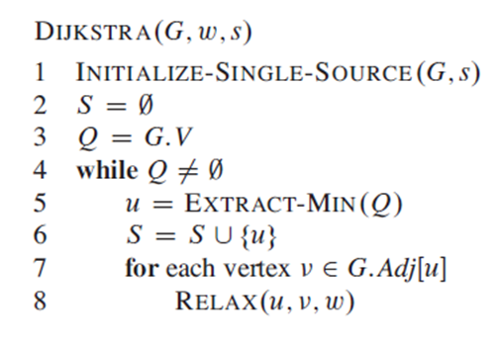
PSEUDO code

Slide 7
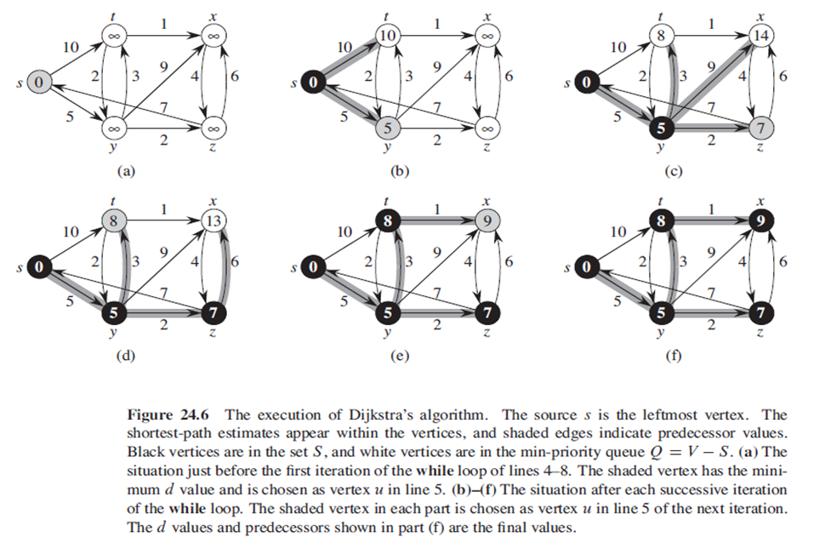
DIAGRAMATIC EXPLANATION

Slide 8
All Pair Shortest Path Algorithm:
•The all pair shortest path algorithm is also known as Floyd - Warshall algorithm is used to find all pair shortest path problem from a given weighted graph.
•As a result of this algorithm, it will generate a matrix, which will represent the minimum distance from any node to all other nodes in the graph.

Slide 9
WORKING
In all pair shortest path, when a weighted graph is represented by its weight matrix W then objective is to find the distance between every pair of nodes.
We will apply dynamic programming to solve the all pairs shortest path.
In all pair shortest path algorithm, we first decomposed the given problem into sub problems.
In this principle of optimally is used for solving the problem.
It means any sub path of shortest path is a shortest path between the end nodes.

Slide 10
Floyd Warshall Algorithm
•We can solve an all-pairs shortest-paths problem by running a single-source shortest-paths algorithm |V| times, once for each vertex as the source.
•Unlike the single-source algorithms, which assume an adjacency-list representation of the graph, Floyd – Warshall algorithm uses an adjacency matrix representation.
•We assume that the vertices are numbered 1, 2, 3, …, |V| so that the input is an n × n matrix W representing the edge weights of an n-vertex directed graph G(V, E).
•The tabular output of the all-pairs shortest-paths algorithms is an n × n matrix D = (d_{ij}) where entry d_{ij} contains the weight of a shortest path from vertex i to vertex j .
Time Complexity for this algorithm
O(|n|³)
where n is the number of vertices in graph

Slide 11
ALGORITHM
•To solve the all-pairs shortest-paths problem on an input adjacency matrix, we need to compute not only the shortest-path weights but also a predecessor matrix П = (π_{ij}) where π_{ij} = NIL, if i = j or there’s no path from i to j, otherwise π_{ij} is the predecessor of j on some shortest path from i.
•For each vertex, i ϵ V, we define the predecessor subgraph of G for i as G_{π, i} = (V_{π, i} , E_{π, i}), where
V_{π, i} = {j ϵ V : π_{ij} ≠ NIL} U {i}
And,
E_{π, I} = {(π_{ij} , j) : j ϵ V_{π, i} - {i}}

Slide 12
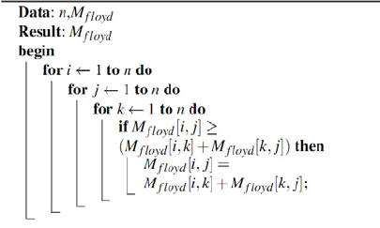
PSEUDO CODE

